Slide 1
STOCK MARKET ANALYSIS
SQL PROJECT
BY -
Saurabh Kumar Soni

Slide 2
CONTENTS
Introduction to Case Study
Objective
Data Analysis
Insights

Slide 3
Case study
Data Source https://www.kaggle.com/datasets/debashis74017/stock-market-index-data-india-1990-2022?rvi=1
This Case Study contains 3 Datasets.
Attributes(Same in all 3 Datasets) – Date, Open, High, Close, Sector.
Data in Dataset is from 2011-08-01 To 2022-01-31.
1st Dataset - Nifty IT Dataset.
2nd Dataset - Nifty FMCG Dataset.
3rd Dataset - Nifty BANK Dataset.

Slide 4
objective
Analyse IT Industry, FMCG Industry and BANK Industry on following parameters -
Volatility.
Drawdown percentage (Time Frame – 2020-02-20 and 2020-03-23).
Recovery days.
Number of days when price closed above its previous day’s close.
CAGR(Returns).
Scoring based on the above criteria.

Slide 5


IT INDUSTRY
The IT sector is a field which is changing the shape of Indian business standards.
This sector includes –
software development, consultancies, software management.
online services and business process outsourcing (BPO).
The IT industry accounted for 7.4% of India’s GDP in FY22, and it is expected to contribute 10% to India’s GDP by 2025.

Slide 6


FMCG INDUSTRY
The Fast-moving consumer goods (FMCG) sector is the 4th largest sector of the Indian economy.
Fast-moving consumer goods are nondurable products that sell quickly at relatively low costs.
FMCGs have low profit margins and high-volume sales.
Examples of FMCGs include milk, gum, fruit and vegetables etc.

Slide 7
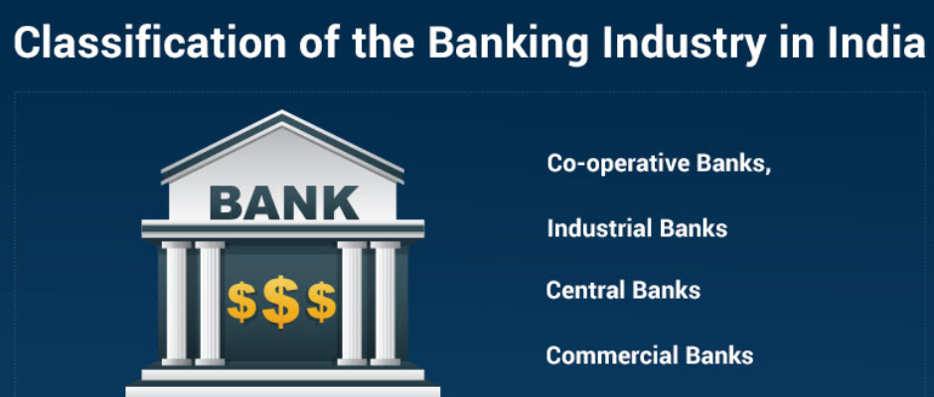
Bank INDUSTRY
Banking is an industry that deals with credit facilities, storage for cash, investments, and other financial transactions.
A bank is an institution that accepts customer deposits and offers loans to individuals and corporate clients.
The banking industry is one of the key drivers of most economies because it channels funds to borrowers with productive investments.

Slide 8


Data analysis
Data analysis is the process of inspecting, cleansing, transforming, and modeling data with the goal of discovering useful information, informing conclusions, and supporting decision-making.
The process of data analysis uses to organize the data in a logical way. It helps to analyze data from different outlooks and a variety of statistical perspectives.

Slide 9
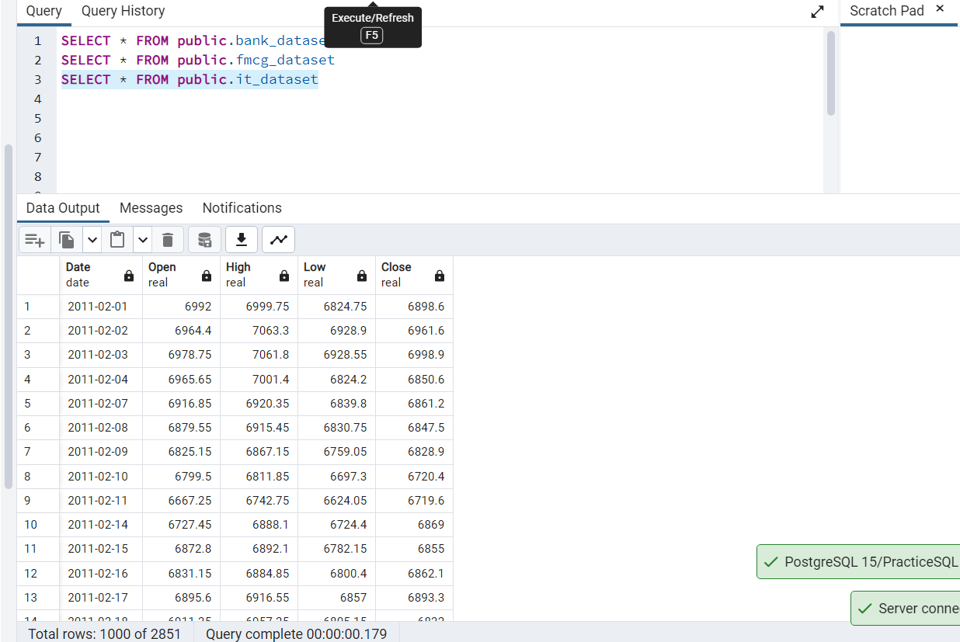
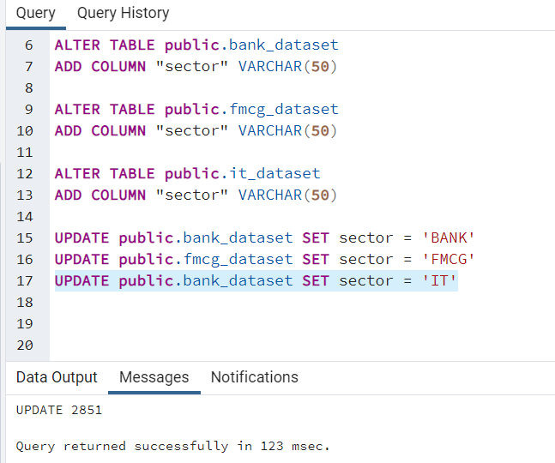
Retrieving data from the table.
Adding a new column sector.

Slide 10
INSIGHTS -
VOLATILITY –
Volatility – In finance , Volatility is the rate at which the price of a stock increases or decreases over a particular period.
Higher stock price volatility often means higher risk and helps an investor to estimate the fluctuations that may happen in the future.
Formula Used – Average(Day High – Day Low) over a period of time.
Volatility – Lower is the better
IT is the least volatile sector
Banking sector is the most volatile sector

Slide 11
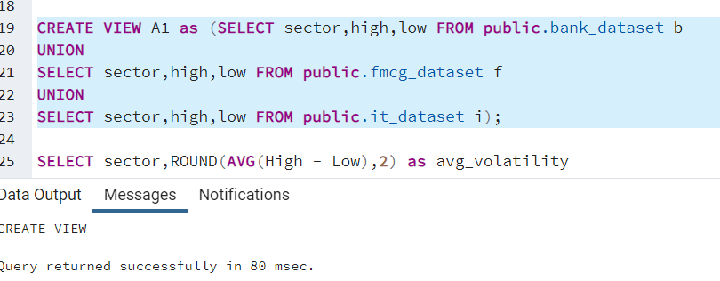
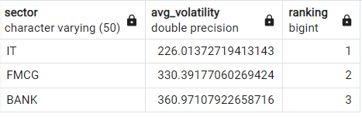
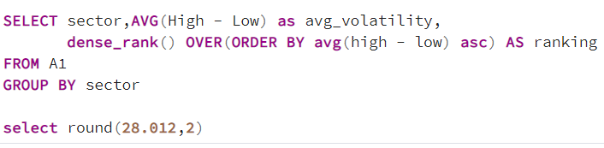
Volatility

Slide 12
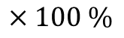
INSIGHTS -
Drawdown (fall in price) –
Drawdown – A drawdown is defined as the percentage of decline in the value over a period before it bounces back to the original value or beyond. It is expressed as the difference between the highest, i.e., the peak and the lowest.
Formula Used –
Percent Increase =
(2020-02-20 to 2020-03-23)
Drawdown – Lower is the better
FMCG is the least Drawdown sector
Banking is the most Drawdown sector
Final Value – Initial Value
Initial Value
$×100 \%$

Slide 13
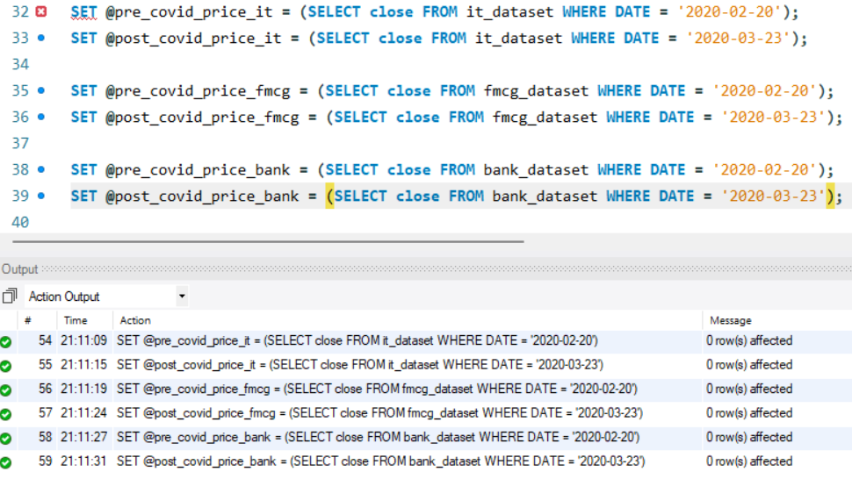
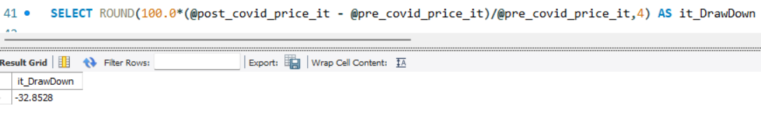
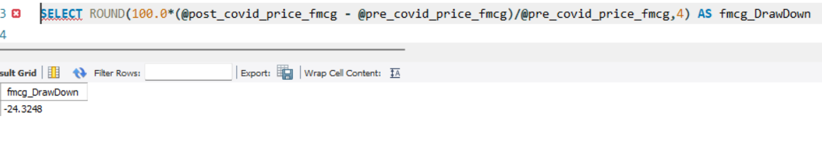
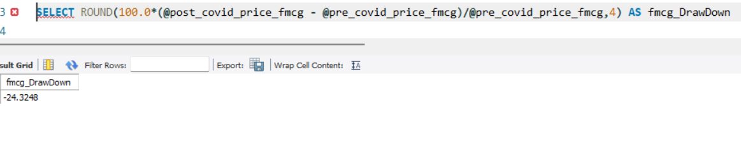
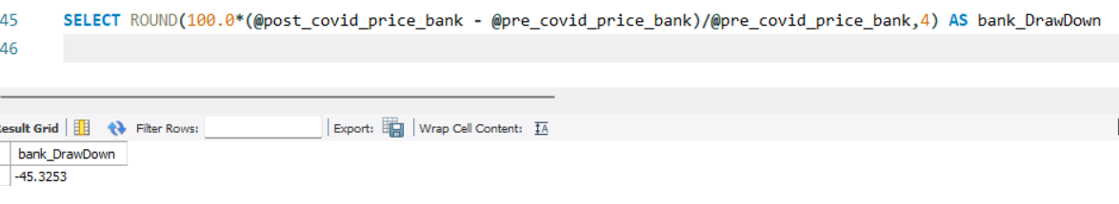
IT Drawdown
FMCG Drawdown
Bank Drawdown

Slide 14
INSIGHTS -
Recovery days–
Recovery Days – Number of days has to taken to close above it’s pre covid price.
Recovery Days – Lesser the better
FMCG – Fastest Recovery
Banking - Slowest Recovery

Slide 15
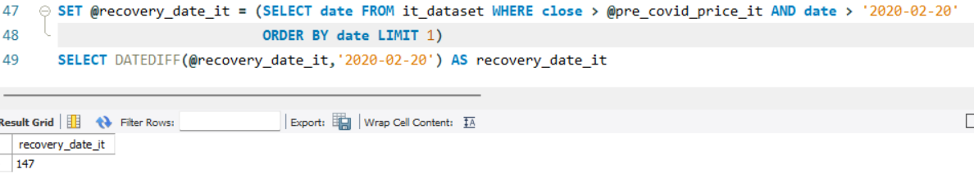

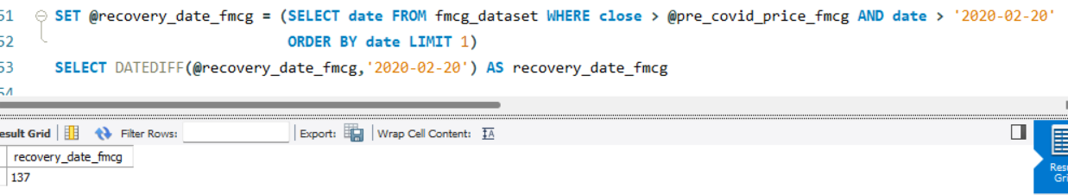
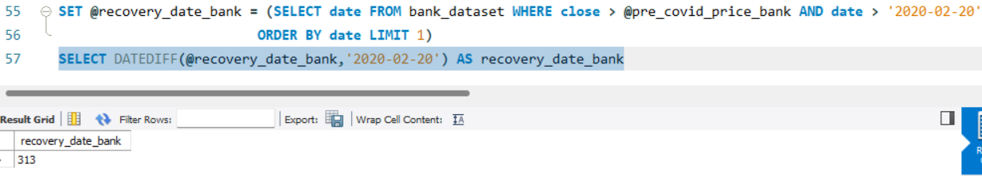

IT Recovery Days
FMCG Recovery Days
BANK Recovery Days

Slide 16
INSIGHTS -
Number of days when stock price closed above its previous day closed price (strength)–
Strength– Higher the better
IT – minimum
FMCG - maximum

Slide 17
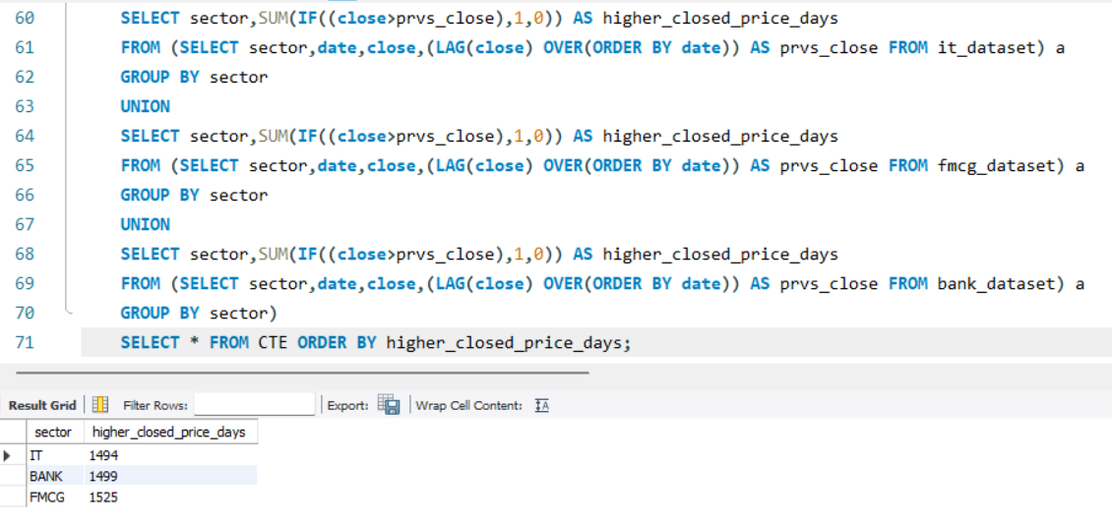
Strength

Slide 18
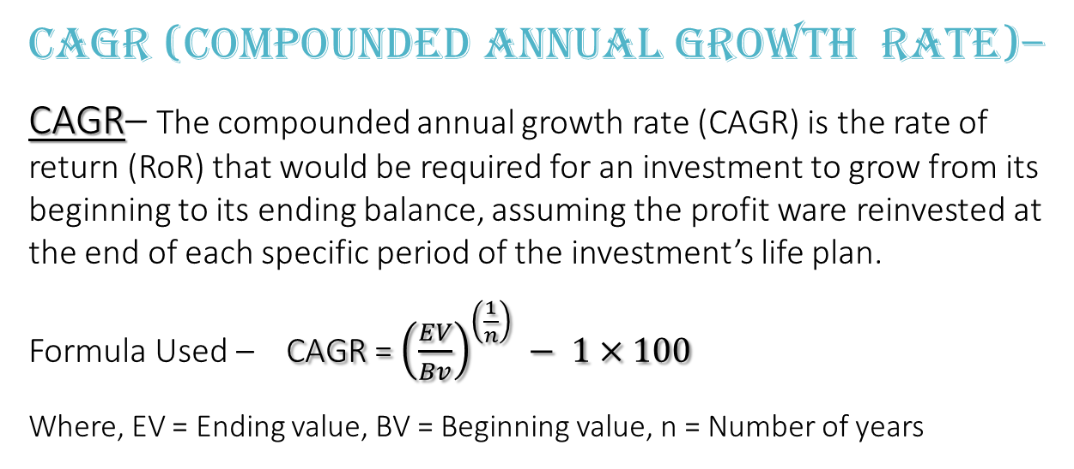
INSIGHTS -
CAGR (COMPOUNDED ANNUAL GROWTH RATE)–
CAGR– The compounded annual growth rate (CAGR) is the rate of return (RoR) that would be required for an investment to grow from its beginning to its ending balance, assuming the profit ware reinvested at the end of each specific period of the investment’s life plan.
Formula Used – CAGR = ${\left(\frac{EV}{Bv}\right)}^{\left(\frac{1}{n}\right)} − 1×100$
Where, EV = Ending value, BV = Beginning value, n = Number of years
CAGR– Higher the better
Bank – Lowest
FMCG - Highest

Slide 19
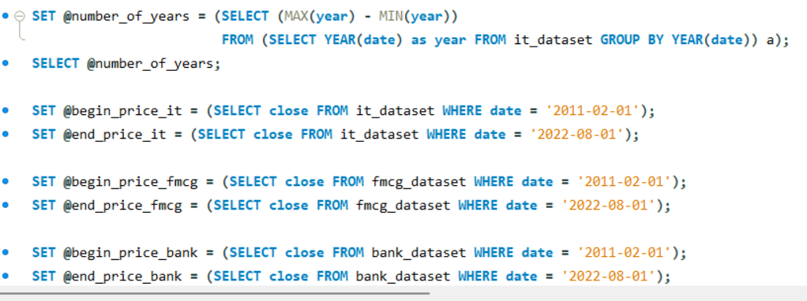
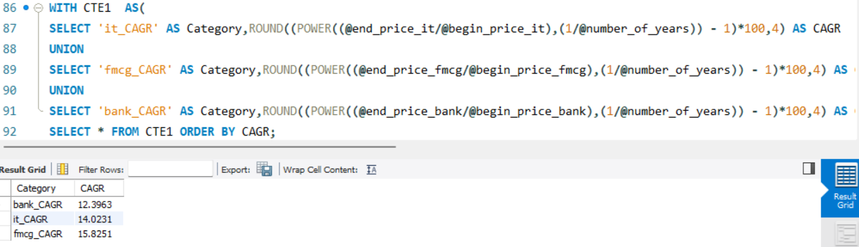

CAGR Return.

Slide 20
WEIGHTAGES AND FINAL SCORE
Weightages Individual Score
Description | Weightage
Volatility | 10%
Drawdown | 20%
Recovery | 20%
Higher_close_above | 30%
CAGR | 20%
Sector | Volatility | Drawdown | Recovery | Higher_close_above | CAGR
IT | 3 | 2 | 2 | 1 | 2
FMCG | 2 | 3 | 3 | 3 | 3
BANK | 1 | 1 | 1 | 2 | 1

Slide 21
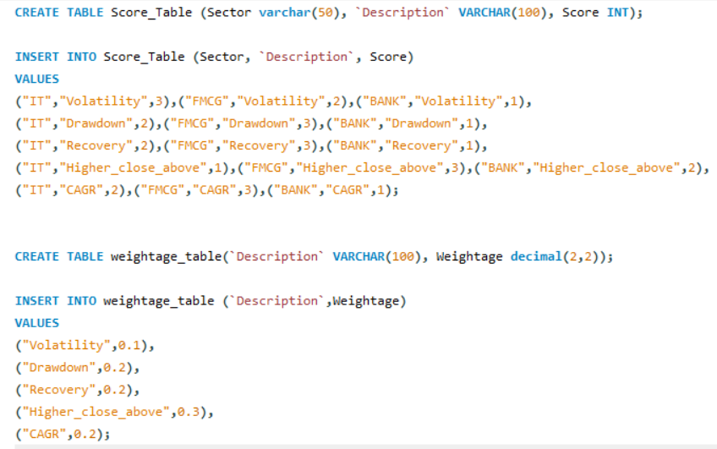
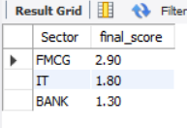
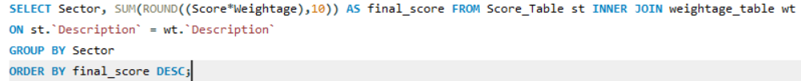
Final Score

Slide 22
Conclusion -
After careful consideration of all parameters and assigning individual scores to each parameter, we proceeded to calculate the final score for each category based on the given percentage of parameter weightage. As a result, FMCG, IT, and BANK obtained the 1st, 2nd, and 3rd rankings, respectively.

Slide 23
References -
Wikipedia, < https://en.wikipedia.org/wiki/Data_analysis>
Fidelity International, https://www.fidelity.com.sg/beginners/what-is-volatility/market-volatility
Wallstreetmojo team, https://www.wallstreetmojo.com/drawdown/

Slide 24
THANK You

